Slide 1

Fundraising
TEAM 8027

Slide 2
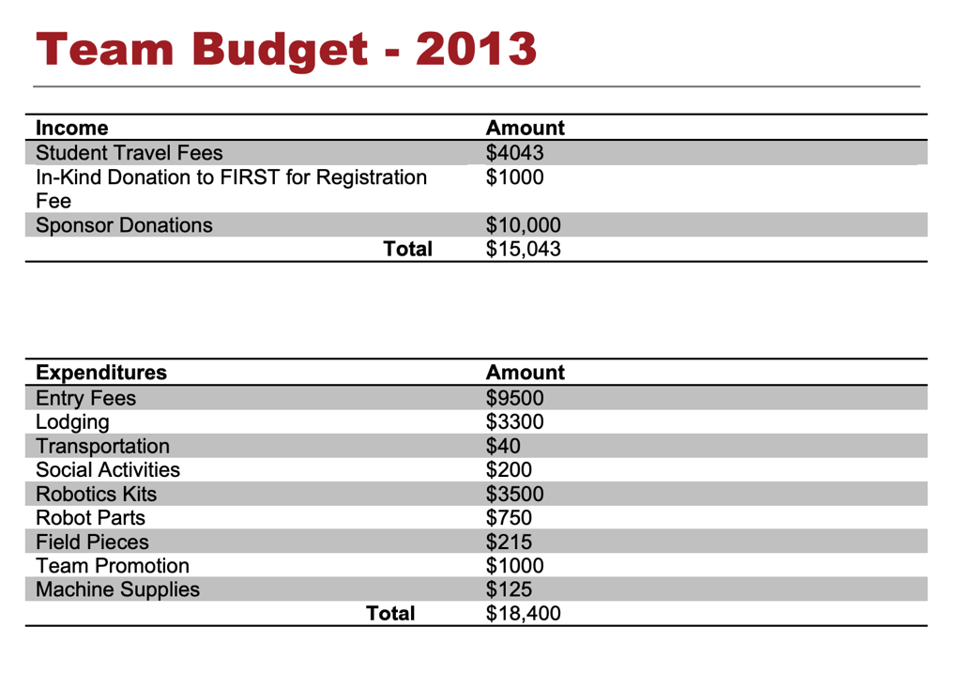
Step 1: Team Budget
Start by creating a team budget for the season
Determine what the student participation fee will be
Now determine your fundraising goal
There are lots of good business plan examples here: https://www.firstinspires.org/resource-library/fundraising-toolkit
Source: FRC 1018

Slide 3
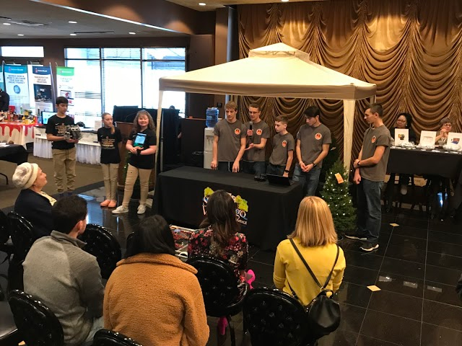
Organizing the Team to Fundraise
It helps to have an initial team meeting dedicated to fundraising before the season begins
Include all team members, coaches, and parents
Use the meeting to learn about possible fundraising connections that everyone involved may have
For example: A parent may have a connection to a funding source that the coaches are not aware of
Always remember, the more people involved, the more resources that will be available for the team.
Ensure all team members participate in fundraising

Slide 4
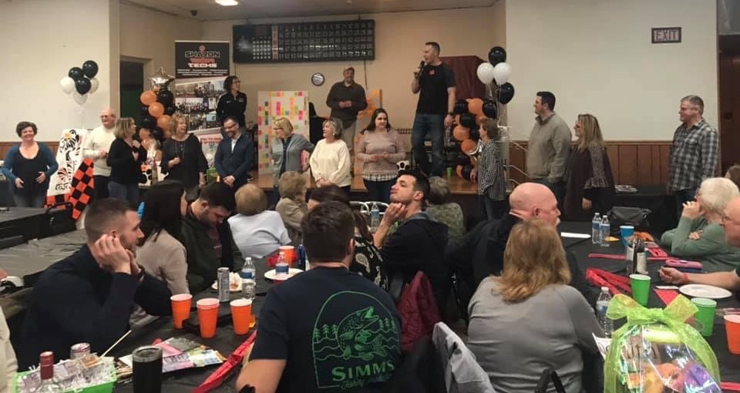
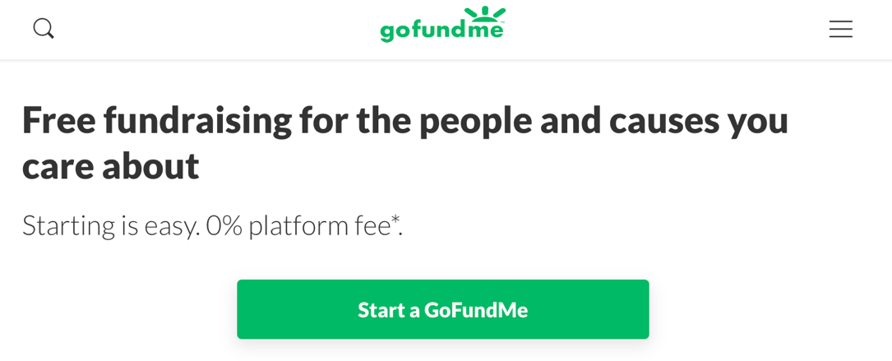
Fundraising Ideas
Food/ Dinner Benefits
Spaghetti Dinner
Door to Door Sales
Candy Bar Sales
Team Sponsors
Businesses
Private Donors
Raffles
Chinese Auction
Reverse Raffle
Crowdfunding
GoFundMe
Patreon
Other online services

Slide 5
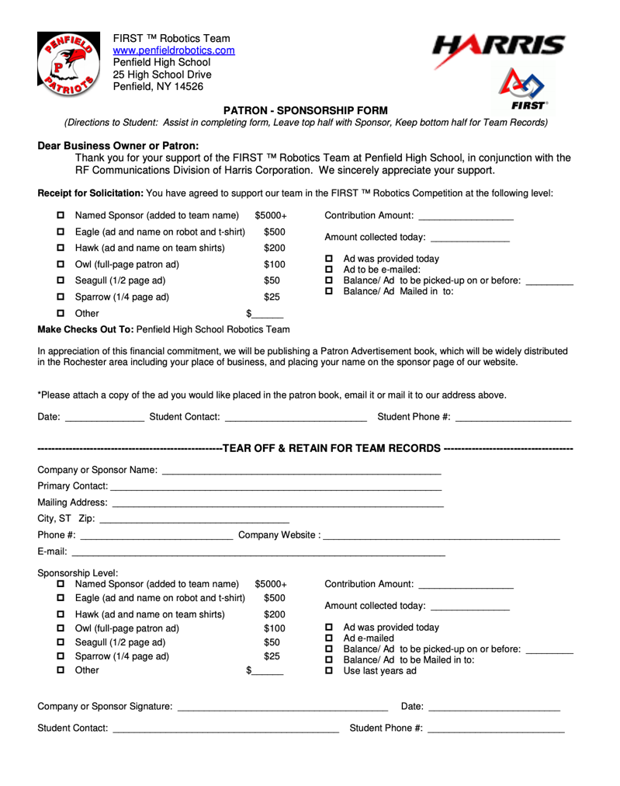
Fundraising Process Tips
Make a list of all different fundraising options to explore
Divide up the process among parents, team members, and coaches. Be sure it is clear everyone has a role in the process.
Schedule follow up meeting(s) to touch base on progress of the the fundraising goals.
Develop a sponsor letter that introduces your team and explains the levels of funding and what the sponsor will gain from supporting your team
Source: Pennfield Patriots

Slide 6
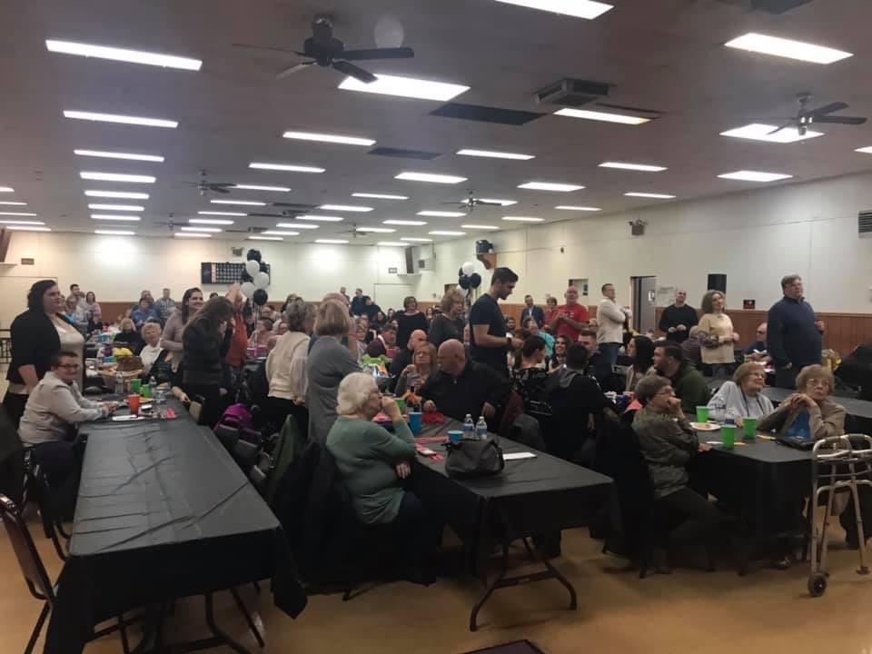
Fundraising Follow Up
After the fundraiser, have a follow up meeting to discuss the success of the fundraising effort
Think about:
What worked about the fundraiser?
What didn’t work or could be improved?
What fundraiser could be used again next year for a similar purpose?

Slide 7
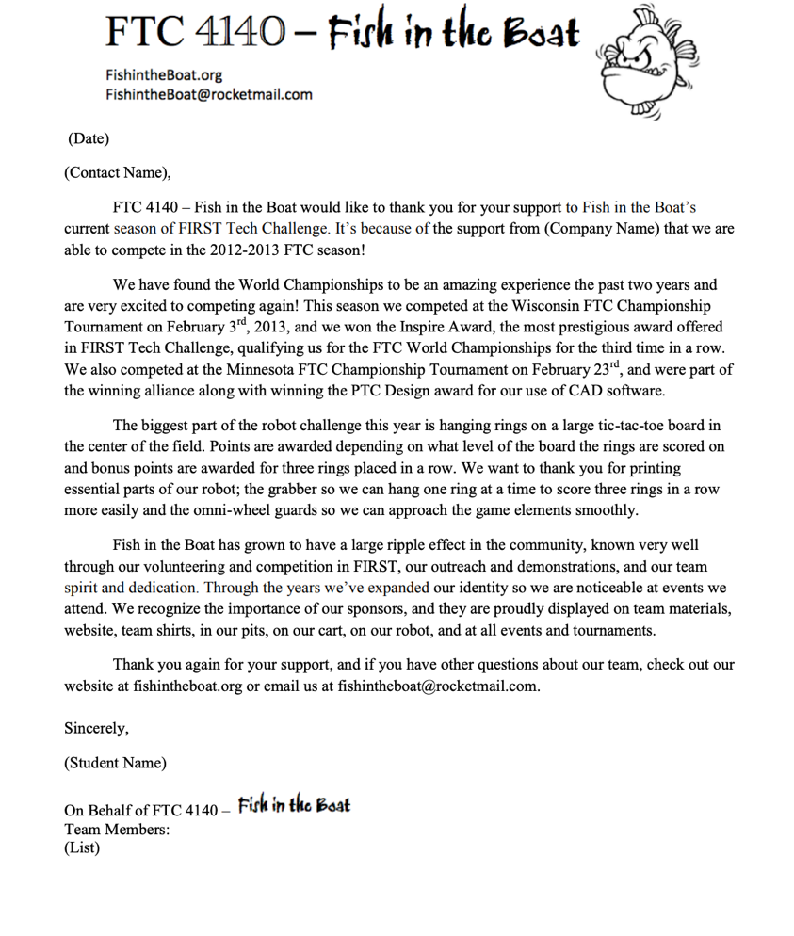
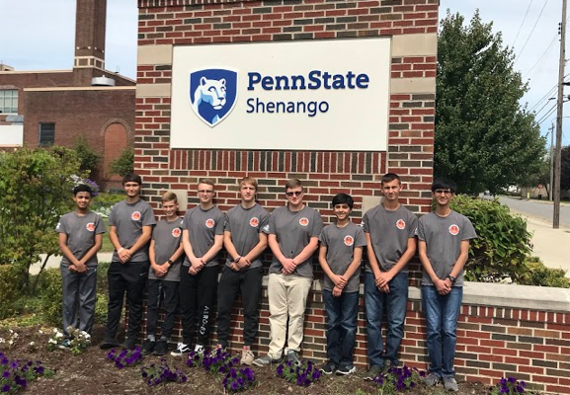
Thank Your Supporters
Send out a letter to those who provided financial support
Giving a shout out on social media or the team’s website
Invite supporters to meet and greet the team.
Include your sponsors on team t-shirts, pit banners and even on your robot.

Slide 8
Useful Links
Fundraising: https://www.firstinspires.org/resource-library/fundraising-toolkit
Make sure to also take look at the lesson on Grants on FRCTutorials.com

Slide 9


Credits
This lesson was written by FRC 8027 for FRCTutorials.com
You can contact the author at team@droidsrobotics.org
More lessons for FIRST Robotics Competition are available at www.FRCtutorials.com
This work is licensed under a
Creative Commons Attribution-NonCommercial-ShareAlike 4.0 International License.

